Slide 1




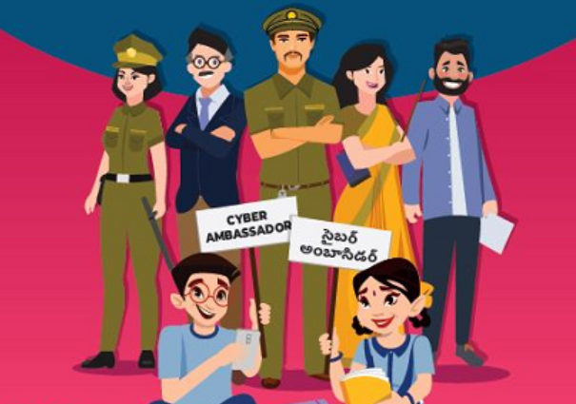
Module 4 Dos and Dont’s of cyber security - Incident Reporting and Incident Response
Sailaja Vadlamudi

Slide 2


Cyber Security Do's and Dont's
Retrieving the Hacked Accounts and How to deal with them preventatives measures
Cyber Laws & their implications
Pocso act and children rights
Where & How to Report Cyber Crime

Slide 3
Cyber Security Do’s and Don’t’ s
Sharing Personal information

Slide 4
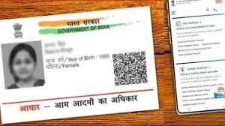
Cyber Security Do’s and Don’t’ s
Sharing Personal information
Email address
Passport number, Visa Details
Driver’s license number
Aadhar number
Bank/credit card account number
Usernames and passwords
Medical records/ Test Reports

Slide 5
Cyber Security Do’s and Don’t’ s
Sharing Personal information
Criminals can piece together widely available information, like a name or birthdate, with Personal identifiable information and they can commit various cyber crimes like identity Fraud, Social engineering attacks so on

Slide 6

Cyber Security Do’s and Don’t’ s
Geotagging
Sharing that you're away on holiday ,announcing that you're not at your home. This could give criminals the chance to target your place of residence, if they know where it is.
Negative consequences of the geotagging. This area used to be a little-known place along the Colorado River in Arizona with a few visitors each year. However due to the geotagged photos in social media it became well-known and receives more than 4 million visitors a year. Visitors are reported to disturb the wild life, cut down trees for firewood and leave behind a huge amount of waste.

Slide 7
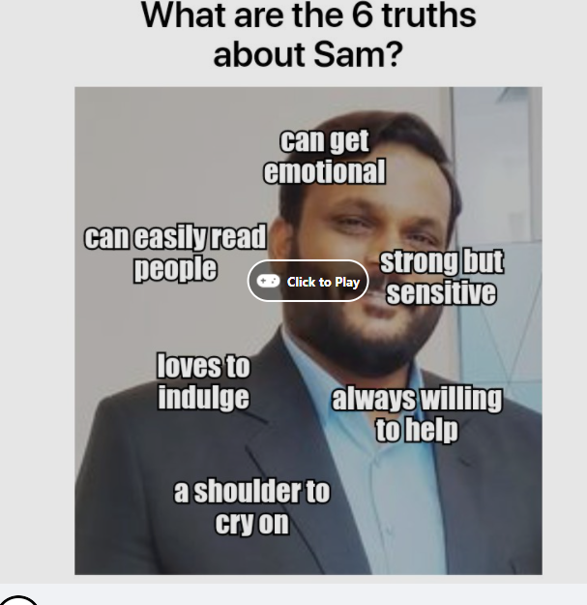
Cyber Security Do’s and Don’t’ s
Doing quizzes and games that require access to profile information

Slide 8


Cyber Security Do’s and Don’t’ s
Inserting USB sticks into devices
Universal Serial Bus

Slide 9


Posting content is one way transaction on internet
In case of posts with strong opinions, thought process and opinions are guaranteed to change.
Apply lot of common sense instead of quick emotions

Slide 10

Shoulder Surfing
Criminals steal personal data by spying over your shoulder as you use a laptop, ATM, public kiosk or other electronic device in public
Entering ATM Pin
Using card pins for instore purchases
Logging into banking applications using id and Password
Surfing Social media accounts on your mobile device
Entering UPI app Pin

Slide 11
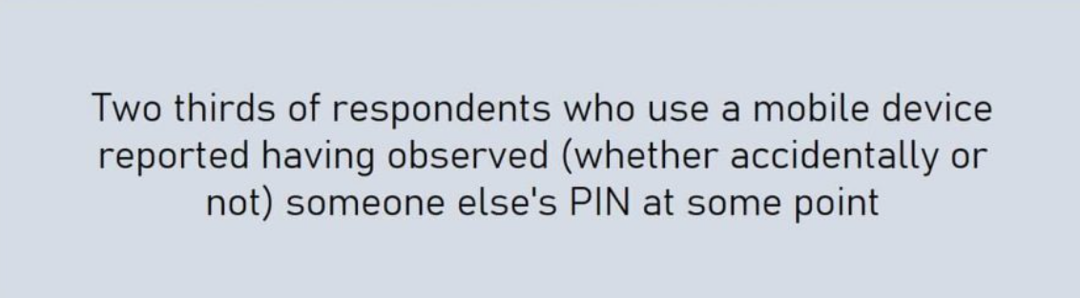
How to Protect from Shoulder Surfing
Add a privacy screen to your devices
Always be aware of your surroundings
Use biometric authentication instead: Biometric authentication, either using your fingerprint or face, can offer additional security that a PIN cannot

Slide 12

Protect your reputation : మీ పేరుప్రఖ్యాతులను సంరక్షించుకోండి
మరియు వ్యక్తిగత కంటెంట్ ను అప్ లోడ్ చేయడం ద్వారా పరిణామాలు- ఈ కంటెంట్ ఆన్ లైన్ లో ఉన్న తరువాత, దానిని తొలగించడం చాలా కష్టం మరియు మీ శాశ్వత ఆన్ లైన్ పేరుప్రఖ్యాతుల్లో భాగం కావొచ్చు.
'కొన్ని ఫోటోలు మరియు వీడియోలు ఇప్పుడు మీకు ఒకేగా అనిపించవచ్చు, అయితే భవిష్యత్తులో వాటి గురించి విభిన్నంగా మీరు అనుభూతి చెందవచ్చు మరియు వ్యక్తులు వాటిని చూడాలని కోరుకోరు'.
Image : https://adigaskell.org/2016/08/24/the-multiple-facets-of-reputation/personal-reputation/

Slide 13

DIGITAL CITIZENSHIP (CYBER LAWS)
ii. CYBER LAWS IN INDIA:
From hacking into computers to making fraudulent transactions online, there are many ways in which we can become a victim of illegal cyber activity. To regulate such activities that violate the rights of an internet user, the Indian government has the Information Technology Act, 2000, in place. Some of the sections are as follows:
● SECTION 65 - Tampering with computer Source Documents
● SECTION 66- Using password of another person
● SECTION 66D - Cheating using computer resource
● SECTION 66E - Publishing private images of others
● SECTION 66F - Acts of Cyber Terrorism
● SECTION 67 - Publishing child porn or predating children online
● SECTION 69 - Government’s power to block websites
● SECTION 43A - Data protection at Corporate level

Slide 14
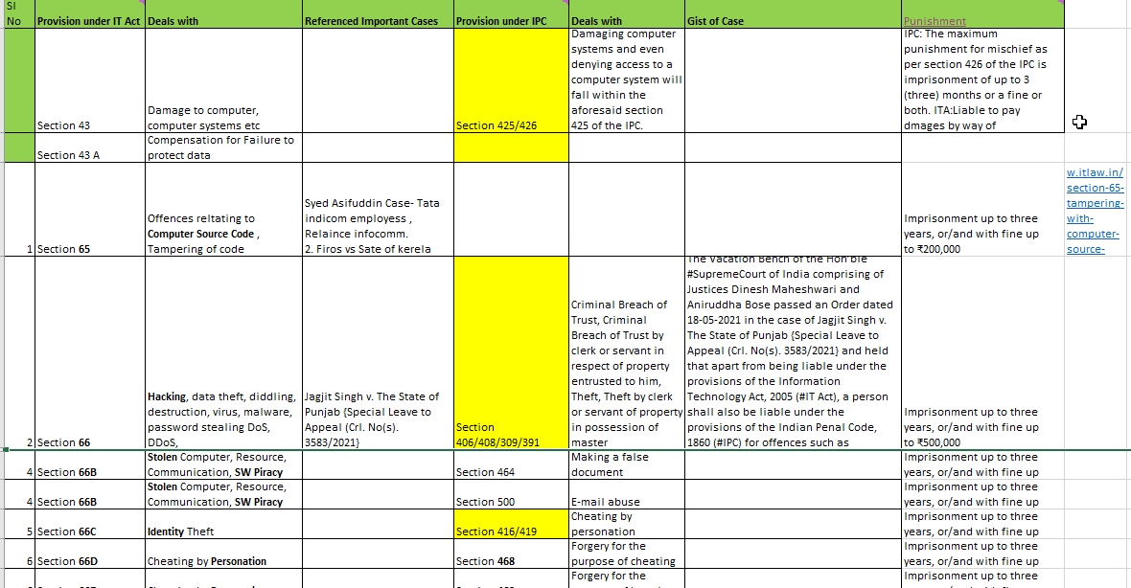

Slide 15
POSCO ACT
The Protection of Children from Sexual Offences Act, 2012. Long Title: An Act to protect children from offences of sexual assault, sexual harassment and pornography and provide for establishment of Special Courts for trial of such offences and for matters connected therewith or incidental thereto.

Slide 16
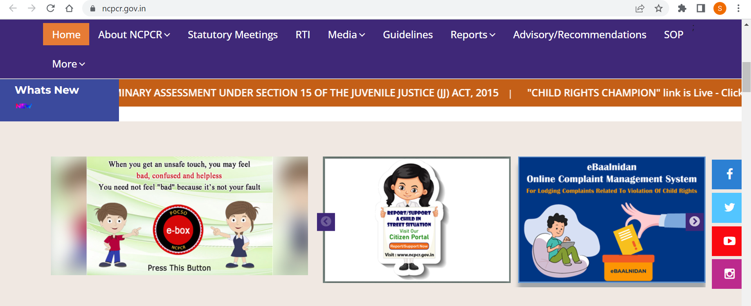
POSCO ACT

Slide 17

POSCO ACT

Slide 18
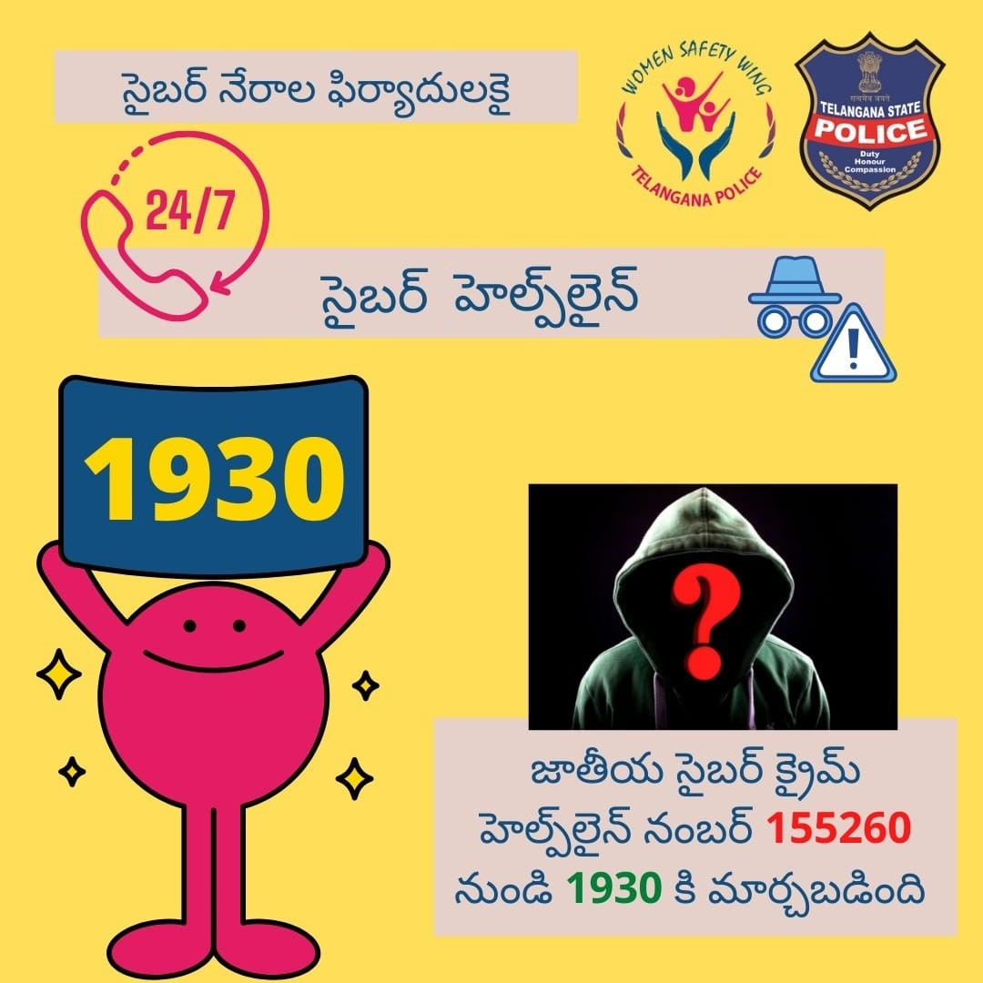
Where & How to Report Cyber Crime
Helpline numbers: Cyber crime- 1930 cybercrime.gov.in She teams non emergency WhatsApp number: 9441669988

Slide 19
Khan Academy- > https://www.khanacademy.org/
Virtual Labs -> https://www.vlab.co.in/
Zygotebody - https://www.zygote.com
NPTEL - https://nptel.ac.in/

Slide 20
Thank You

